Slide 1

Bitcoin Price Prediction Using Machine Learning
Hiranmai Suryadevara

Slide 2
OBJECTIVE

Slide 3
Dataset:"C:\Users\surya\Downloads\bitcoin_data.csv"
Features and label:
Timestamp: Every date that bitcoin value changes from 2017 to 2018.
Open: The starting value of a day at 12 AM.
High: The highest value in a whole day.
Low: The lowest value in a day.
Close: The end value of the day at 11.59 PM.
Volume(BTC): Volume of bitcoin in that particular day.
Volume(Currency): Volume of currency according to that bitcoin in that day.
Weighted Price: This is currency divided with bitcoin volume.

Slide 4
APPROACH

Slide 5
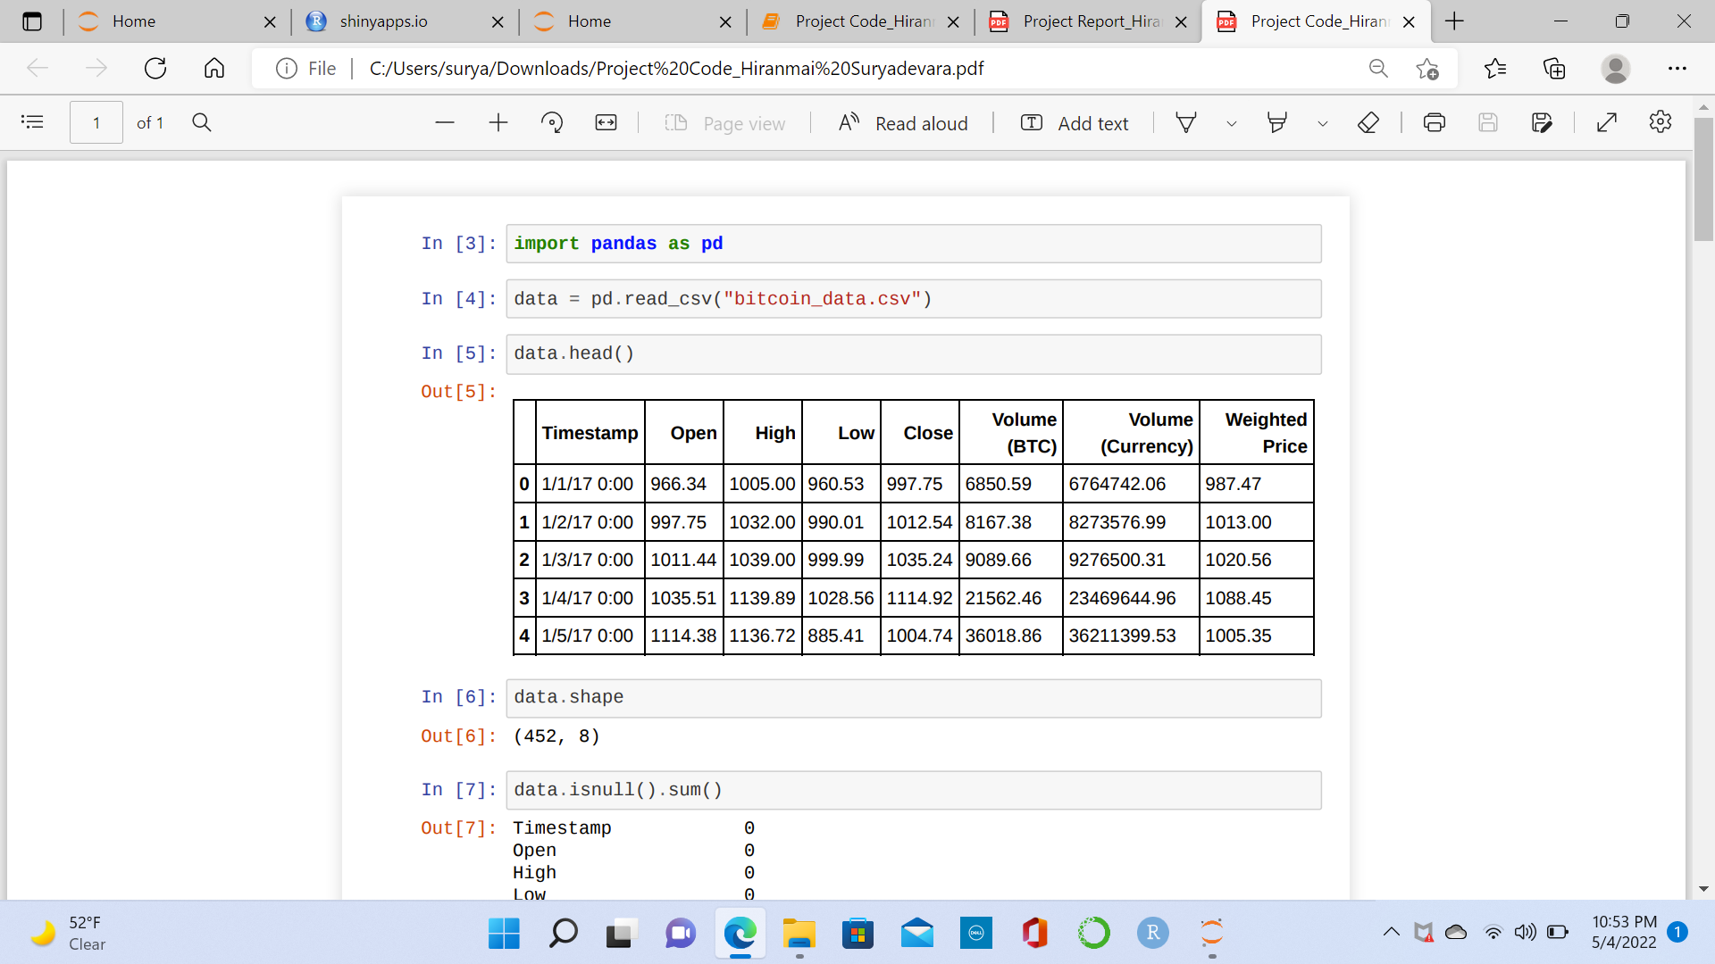
CODE SNIPPETS

Slide 6
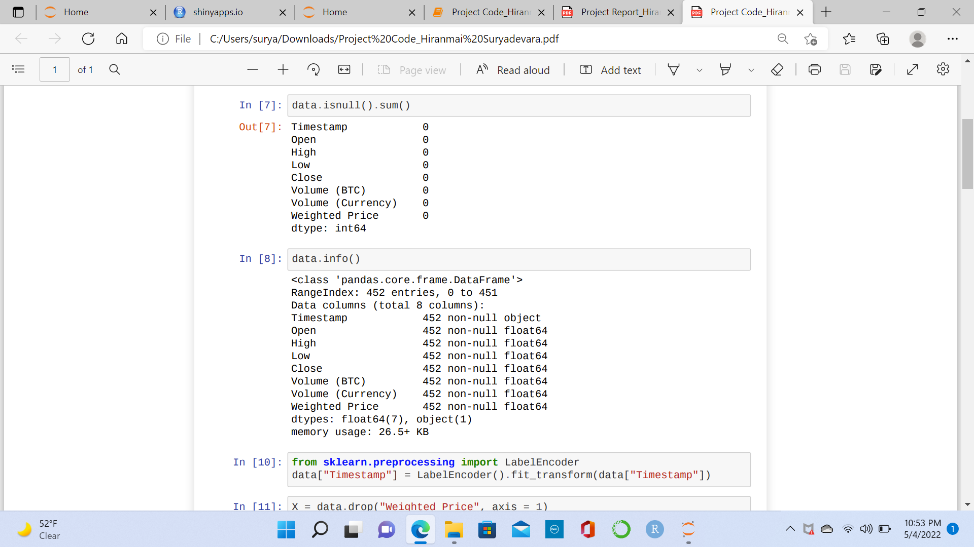
DATA CLEANING

Slide 7
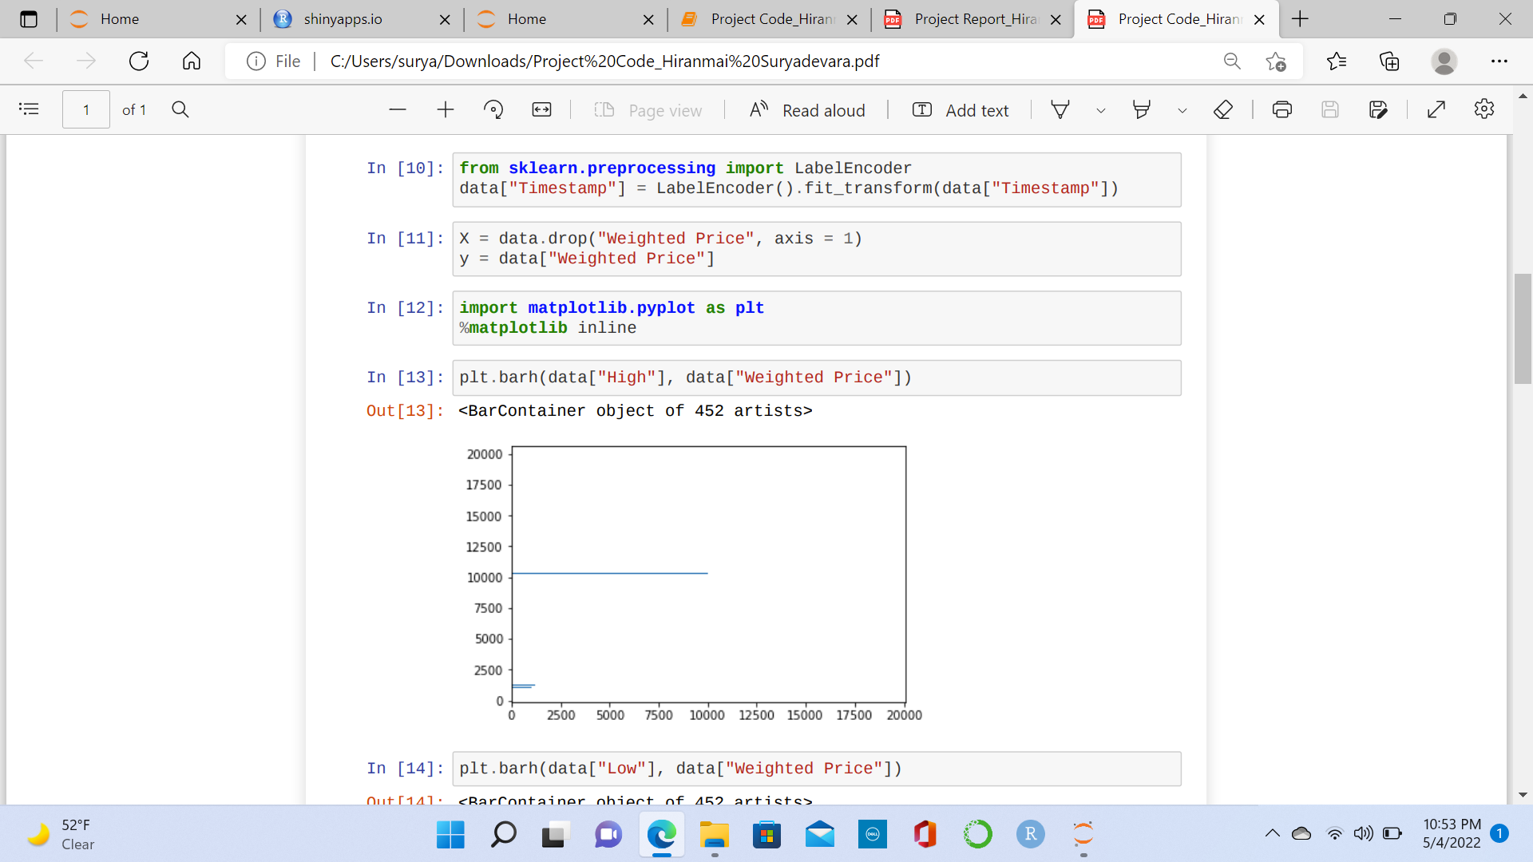

Slide 8
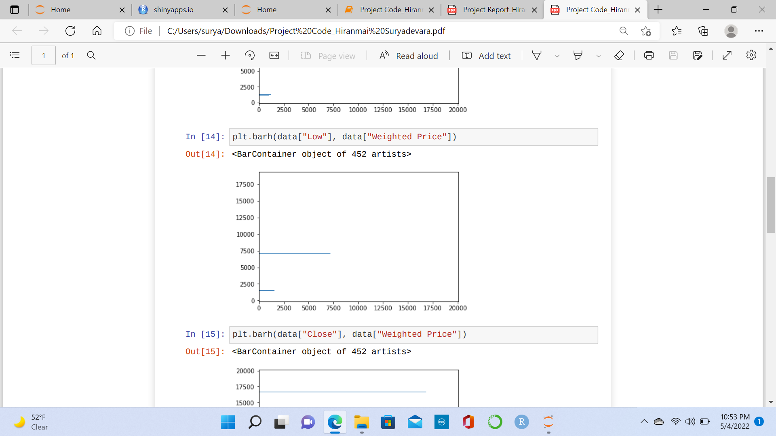

Slide 9
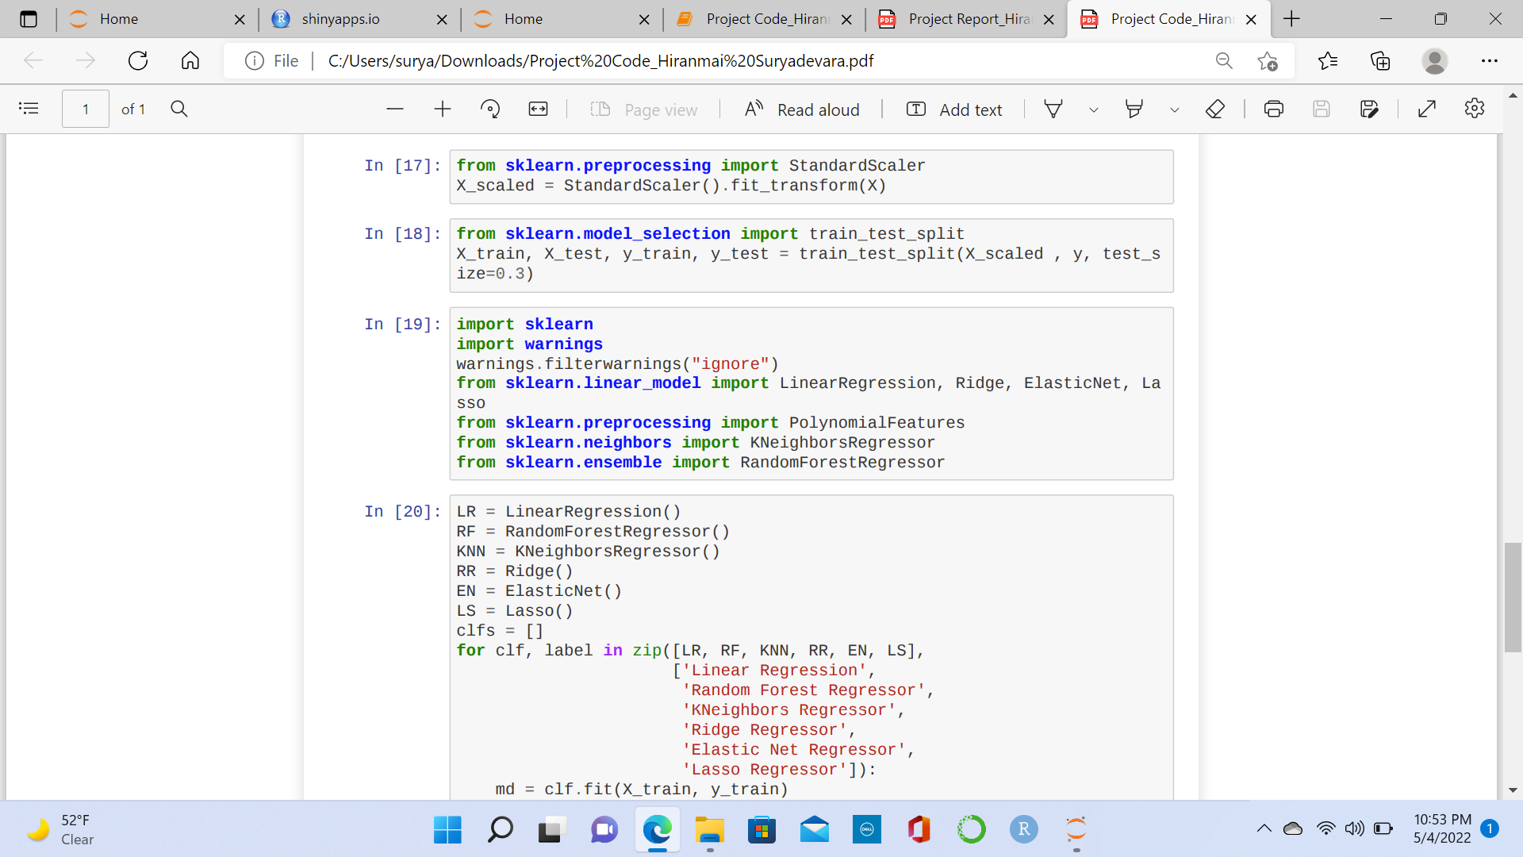
DATA NORMALIZATION

Slide 10
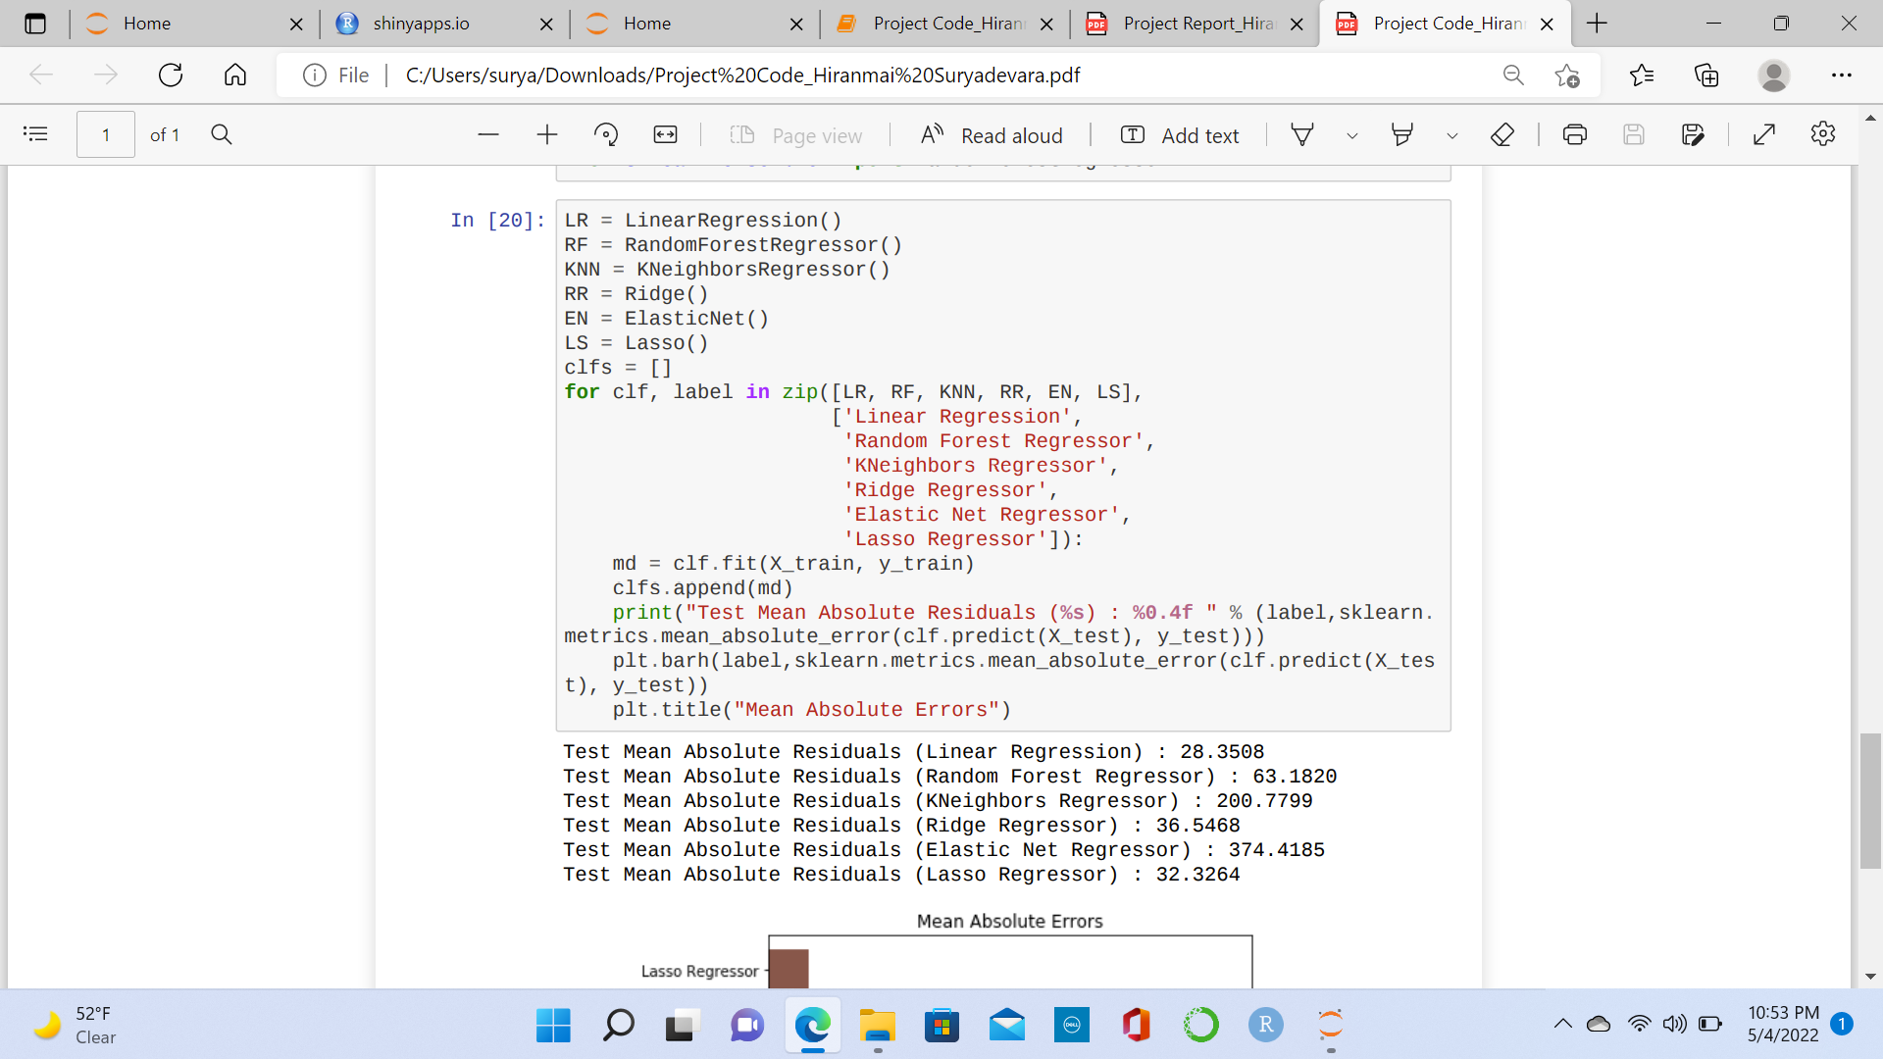
MODEL EVALUATION

Slide 11
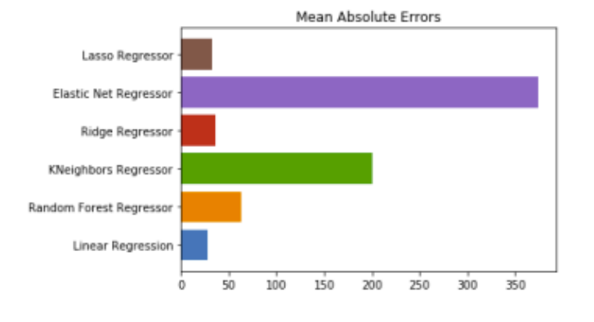
Results

Slide 12
Conclusion
Test Mean Absolute Residuals (Linear Regression) : 28.3508
Test Mean Absolute Residuals (Random Forest Regressor) : 63.1820
Test Mean Absolute Residuals (KNeighbors Regressor) : 200.7799
Test Mean Absolute Residuals (Ridge Regressor) : 36.5468
Test Mean Absolute Residuals (Elastic Net Regressor) : 374.4185
Test Mean Absolute Residuals (Lasso Regressor) : 32.3264
Out of all models Linear Regression has less Mean absolute error. So, for this data set Linear Regression gives Accurate Predictions.

Slide 13
THANK YOU

